Slide 1
a

Slide 2
a
Social Coding
Notes:
Hello everyone! Today I’m talking about Social Coding.

Slide 3
The most important aspect of building software, is the thing we spend the least amount of our energy on and is the part we're the worst at.
Notes:
This talk is a little different than the ones I normally give. Rather than talk about GitHub or how to run an OSS project well, I want to take a step back and talk about how we can run an OSS community well. How we can make our community better and more effective. It builds upon some of the themes that Kathleen Dollard spoke on Sunday night. We didn’t plan that, it’s just a serendipitous outcome. Thanks Kathleen! Note that when I say I want to talk about how to be better, it’s out of excitement. Like learning a new technique to write better code!

Slide 4
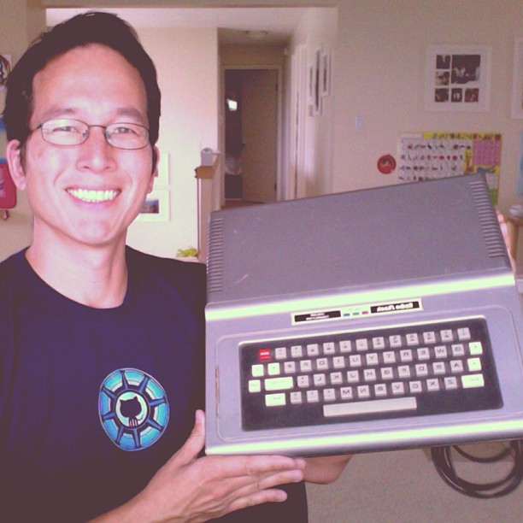
Phil Haack
@haacked
https://haacked.com/
Notes:
But first, a little about me. My name is Phil Haack and I'm on Twitter and I keep a blog. I got my first computer when I was around 5 or 6. As you can see, I was pretty mature for my age. I've been in love with computers ever since. I want everyone to have the same opportunity to enjoy this field as I do.
I know it's hard to tell by my spiffy threads, and the fact that I use the words "spiffy" and "threads," but I'm not one to chase trends. I'm not trendy. I’m not up on Angular, Node, F#, Swift, Durandal, Aurelia, etc. These are all worthy and interesting technologies, don't get me wrong. It's been really exciting to hear more about them at this conference. But I tend to think we fetishize technology too much.

Slide 5
“
THE MAJOR PROBLEMS OF OUR WORK ARE NOT SO MUCH TECHNOLOGICAL AS SOCIOLOGICAL IN NATURE.
- TIMOTHY LISTER and TOM DEMARCO in PEOPLEWARE
“
Notes:
How many of you have read Peopleware? Great. The central thesis of Peopleware is that... Projects rarely fail because the algorithms aren't right or we didn't JavaScript hard enough. They fail because of people issues. Coordination. Miscommunication. Misunderstanding the customers Etc.So while we spend so much time rediscovering the work that our computering forebears already discovered in the 60s and 70s, we spend so little energy on the part that might make a real difference in how effective our companies and communities can be.

Slide 6
THERE’S A LOT TO ADMIRE ABOUT OSS
Notes:
So let's talk about being a better community. In many respects, there's a lot to admire about the open source community. There's a real focus on ideas and merit over dogma. Openness and transparency is a core principle. It's these things we wished our governments aspired to.

Slide 7
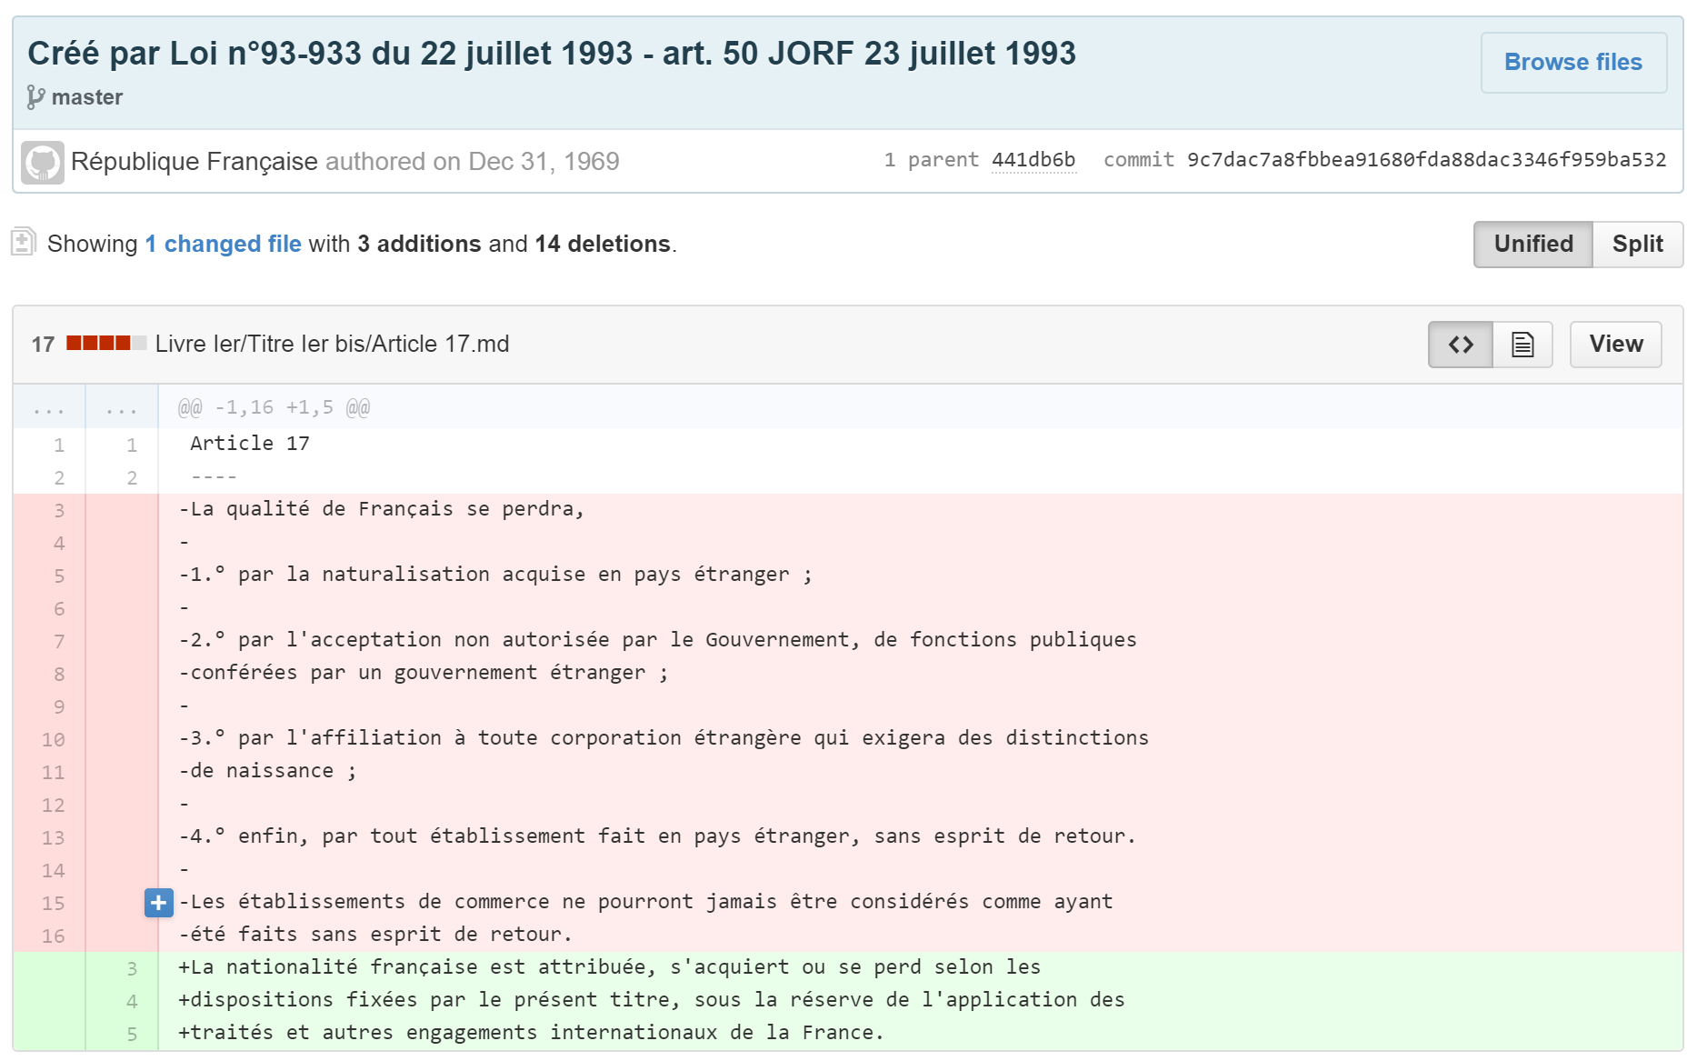
Notes:
Imagine if changes to the legal code were done on GitHub. Here's what that could look like-The French Legal code since Napoleonic times. This is not done by the French govt, but individuals. But imagine if every govt had this transparency.
Yes, there are many parts of the OSS community that are commendable. However, in practice, we can't be too self congratulatory. We often ignore the very real social problems in the community.

Slide 8

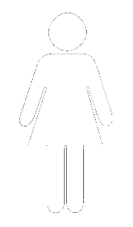
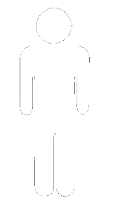
Notes:
According to the FLOSS 2013 survey, 11% of OSS developers are women. Note that women comprise around 26% of computing related job according to the Dept of labor. That is quite a disparity. I found it hard to find reliable data on ethnicity and open source, which I would imagine would have a similar disparity. Thus the focus on women. Clearly we can only assume that women are not as altruistic as men.

Slide 9
X
Women just aren’t interested or
predisposed to programming or
open source
Notes:
It might be easy to dismiss this as women not being capable or interested in OSS. I think that's intellectually lazy to fall upon that hypothesis and ignore all the other possible causes.In fact, there was a study that demonstrated this sort of "essentialist" thinking, associating racial differences with ability and personality traits, leads to lack of creativity. Folks who believe this don't think outside the box. They can't imagine alternative solutions.

Slide 10
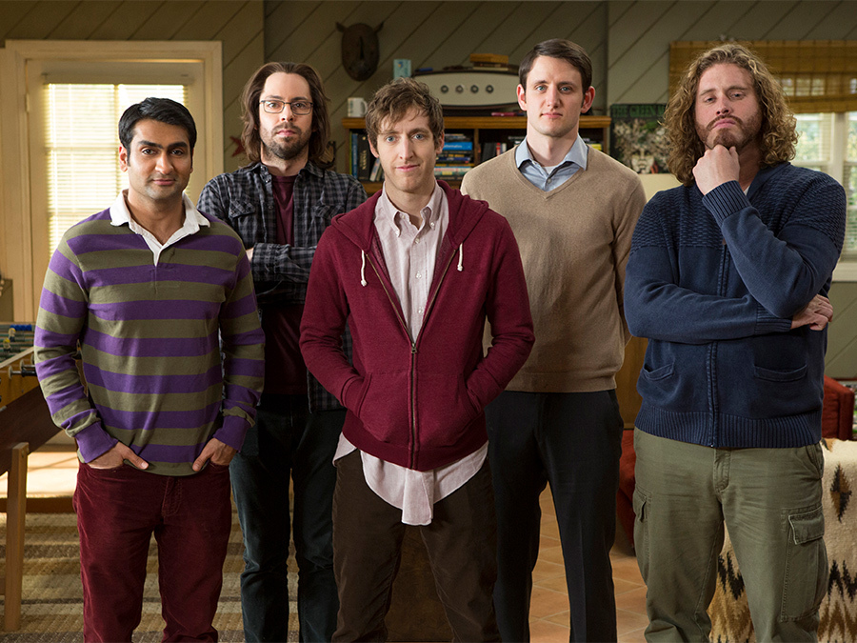
Notes:
To them, this is what programmers look like because of inherent traits.

Slide 11
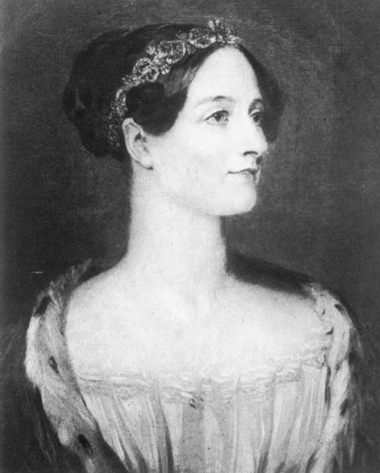
ORIGINAL HIPSTER PROGRAMER
Coding before there were even computers
Notes:
It wasn’t always this way. This is a picture of the first programmer, Ada Lovelace. For a brief shining moment in history, 100% of programmers were women.

Slide 12
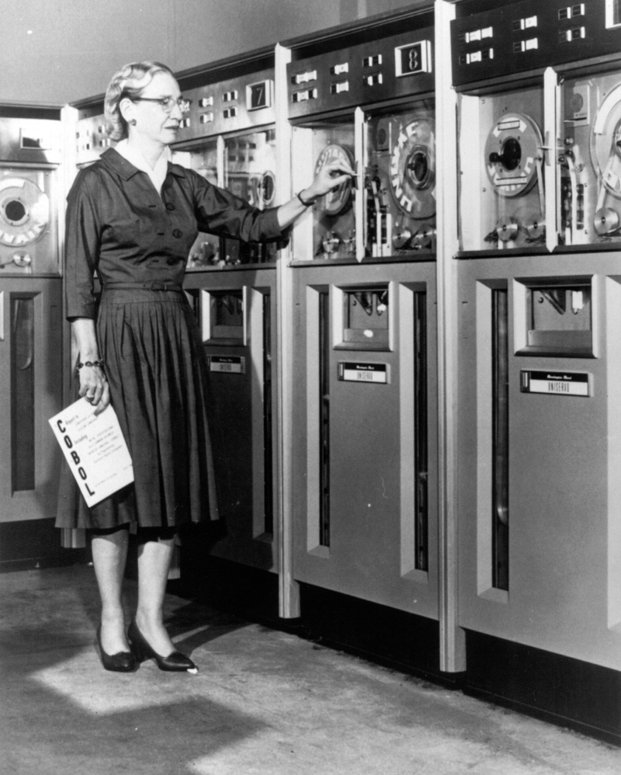
“
THE MOST IMPORTANT THING I'VE ACCOMPLISHED, OTHER THAN BUILDING THE COMPILER, IS TRAINING YOUNG PEOPLE.
- GRACE HOPPER
Notes:
Admiral Grace Hopper wrote the first compiler.

Slide 13
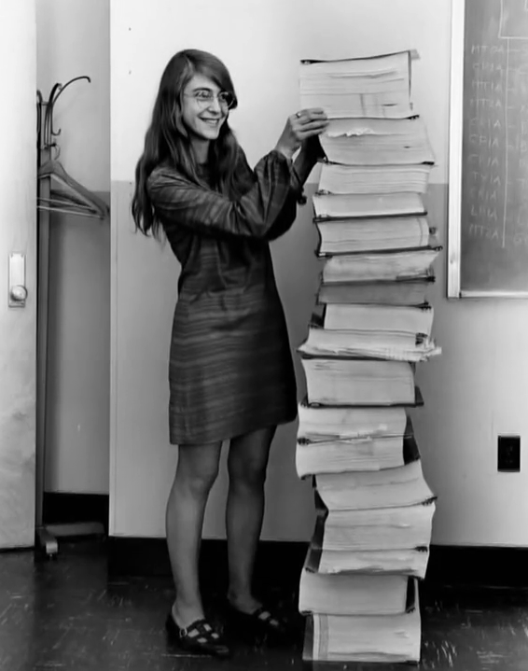
OG PULL REQUEST
Real developers send people to the moon
Notes:
Margaret Hamilton developed on-board flight software for the Apollo space program.

Slide 14
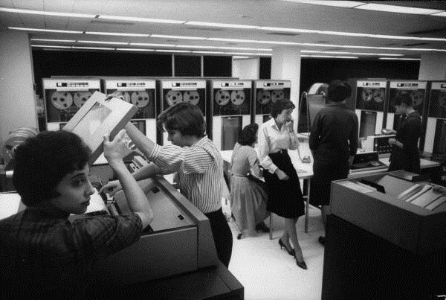
Programming is women’s work
Notes:
The same site where I found that quote has a link to this great Life Magazine archive photo of IBM computer operators. Back in these days, Programming was considered women’s work. The decline of women in the tech industry wasn’t due to inherent changes. It was an active societal change that pushed them out.

Slide 15
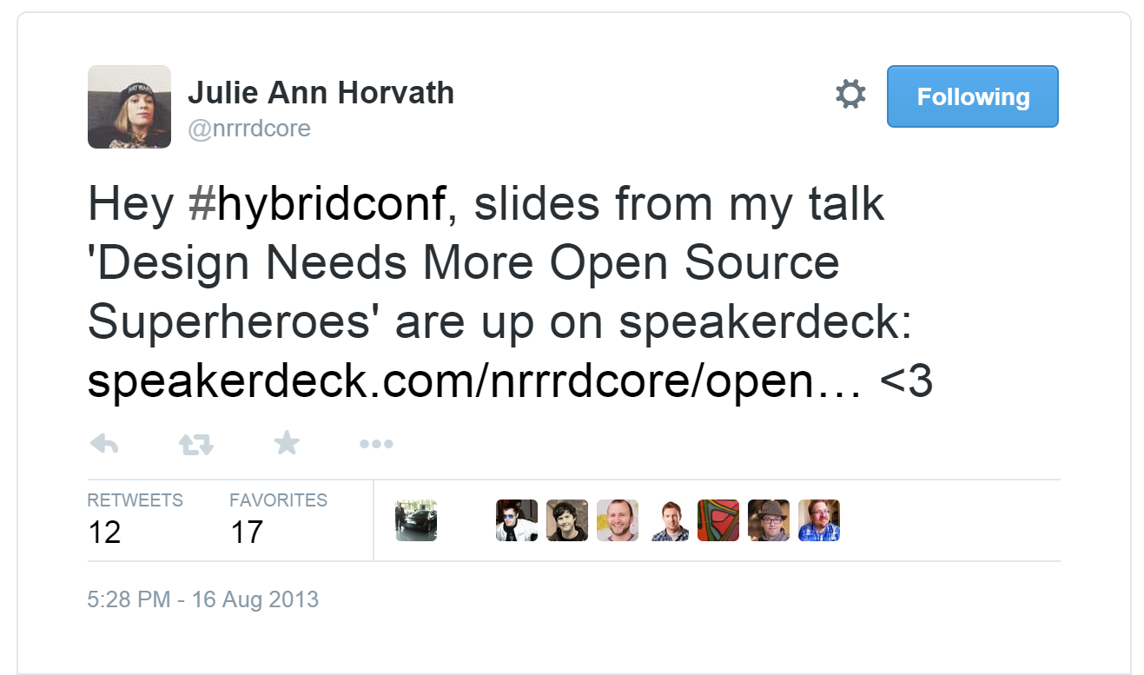
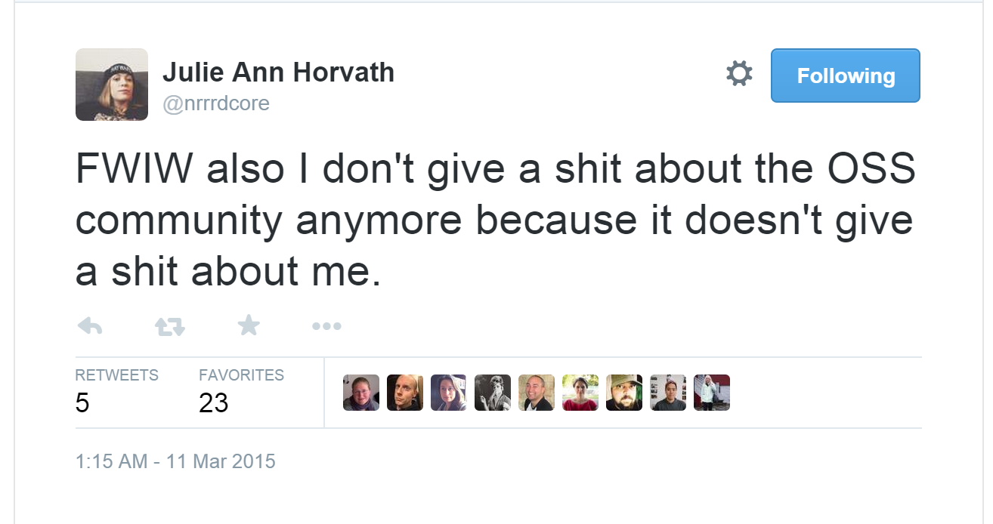
Three Years Later…
Notes:
What happened?! A friend of mine recently posted two tweets three years apart. Three years ago, she wrote "I heart open source software." She was involved. Three years later, she tweets, "FWIW also I don't give a shit about the OSS community anymore because it doesn't give a shit about me."

Slide 16
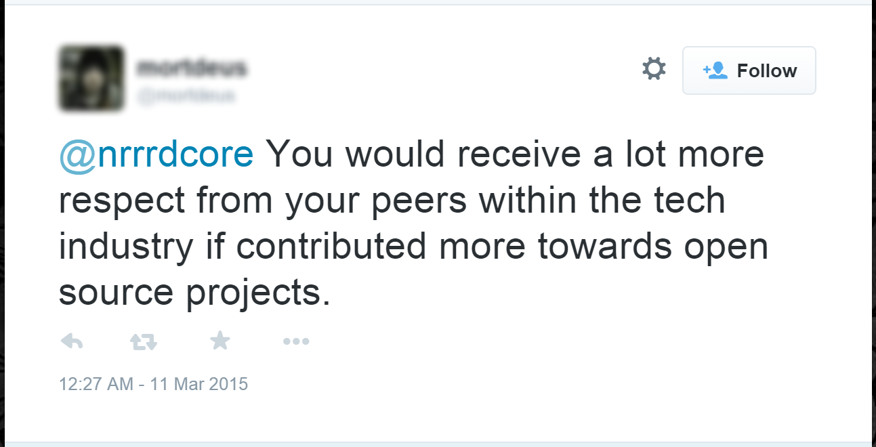
Notes:
It's been well documented that women receive a lot more abuse than men on forums like Twitter.

Slide 17
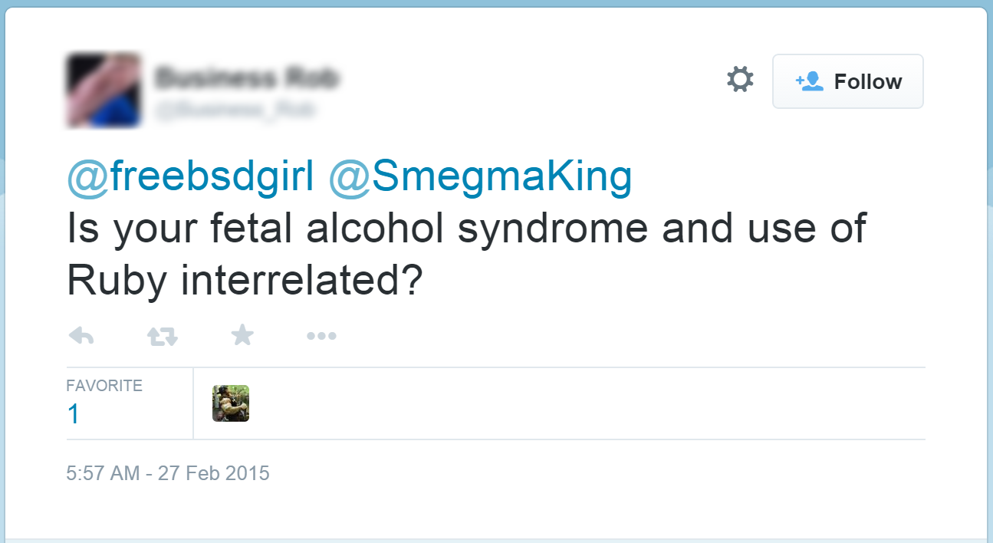
Notes:
People are particularly rude to women developers.

Slide 18
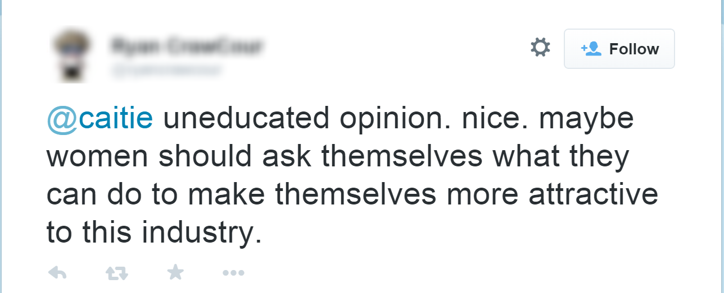
Notes:
In part, I think it’s the cognitive dissonance I mentioned before. Women developers don’t fit neatly into these folks preconceived notions of what makes a developer. So they lash out.

Slide 19
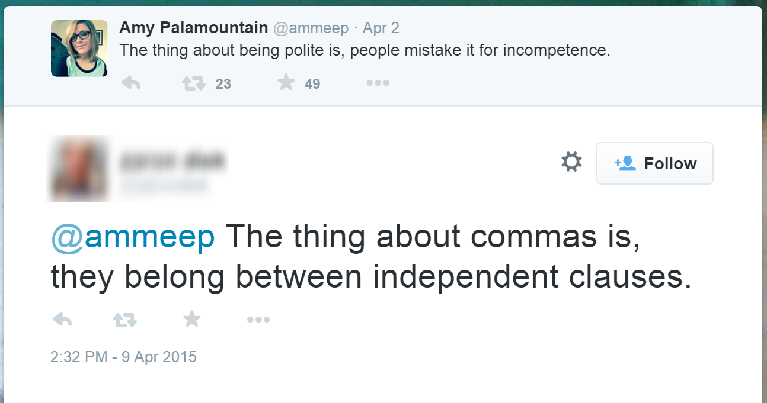
Notes:
The find every reason to try and discredit them. Here’s our very own Amy. From her talk yesterday, we know she’s extremely competent. Remember, if a woman tells you this happens, don’t tell her experience is wrong just because you’ve never seen it. Listen. Reflect. Don’t be like these people on Twitter. This is also not my experience. I don’t have people doing this to me. But I believe the women I work with when they tell me it’s common and pervasive. I have no good reason not to.

Slide 20
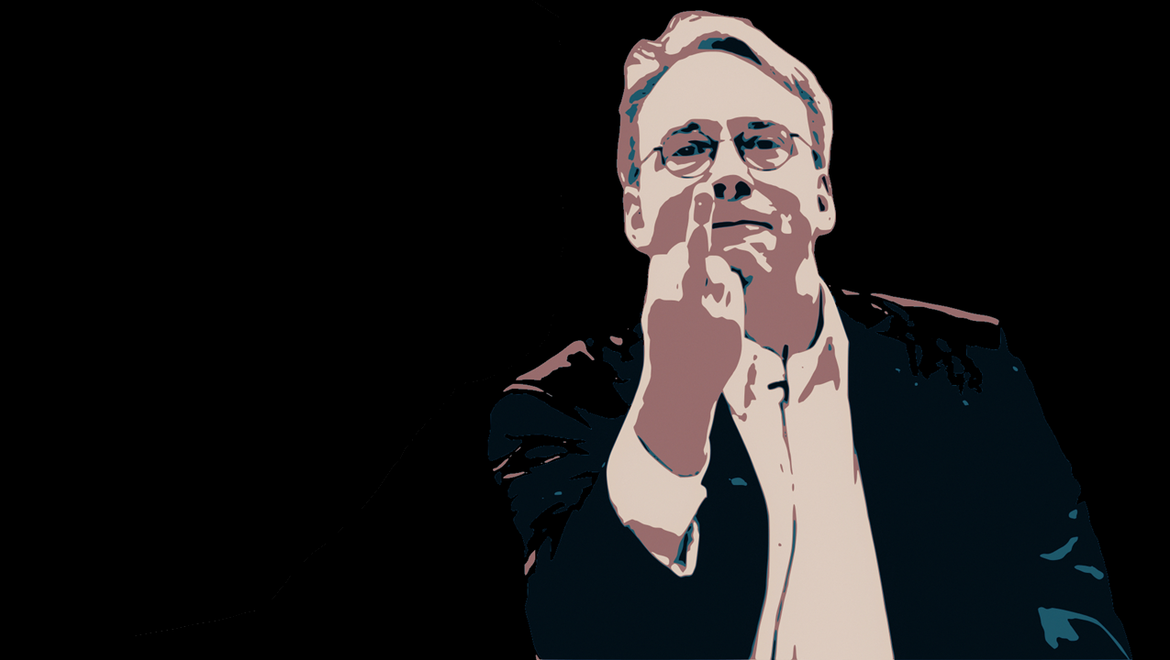
Notes:
These attitudes are a big part of what creates an environment that isn’t attractive to women. It’s an environment that tells women, they are not welcome here and they do not fit in.
There’s a lot of hoodlums in the community. We create myths around figures in this community that glorify this behavior. We can build a more welcoming environment.

Slide 21
“
MARGINALIZED PEOPLE IN TECH — WOMEN, PEOPLE OF COLOR, PEOPLE WITH DISABILITIES, LGBTQ PEOPLE, AND OTHERS — HAVE LESS FREE TIME FOR A FEW MAJOR REASONS: DEPENDENT CARE, DOMESTIC WORK AND ERRANDS, AND PAY INEQUITY.
“
- ASHE DRYDEN
Notes:
An unwelcoming environment isn’t the only factor in play here. As Ashe Dryden writes, there are other societal issues in play. Women tend to make less money than men, are more likely to be the primary caregiver, etc. This reduces the free time they would have to contribute to OSS.

Slide 22
WHY DO WE CARE?
Notes:
Hopefully because we’re decent people. Because we have empathy and we value fairness and equality. Isn't equality a core principle of OSS?

Slide 23
“
BEING IN TECH AND NOT CARING ABOUT TECH CULTURE IS A LUXURY, ONLY AFFORDABLE TO THOSE WITH ENOUGH PRIVILEGE TO IGNORE IT & TOO LITTLE EMPATHY TO CARE.
“
- LENA REINHARD
Notes:
Lena Reinhard (@lrnrd) in her [Talk about nothing](https://www.youtube.com/watch?v=D3e3V66TH2Y) notes...
Focusing on tech and trying to ignore the social issues is like trying to learn Physics, but deciding Math is not worth your time.
But maybe appealing to empathy is, sadly, too much to ask, so I'll give some ROI arguments, in the parlance of business.

Slide 24
Diversity is a competitive advantage
Companies with higher proportions of women board directors outperform others by 53%.
On average, companies with the highest percentages of women board directors outperformed those with the least by…
Return on equity: 53%
Return on sales: 42%
Return on invested capital: 66%
Notes:
http://www.catalyst.org/media/companies-more-women-board-directors-experience-higher-financial-performance-according-latest

Slide 25
Complex decision making improves
It’s not only do the addition of women and people of color contribute something unique from those members, research shows that everybody else contributes something unique. Everybody benefits
Notes:
When everybody is the same, you overemphasize the qualities in common. Memes. Bacon. Freer to express something different, with different people in the group.
Perhaps when you have a heterogenous group, someone will ask, do we really need yet another OSS JavaScript framework? Are there other important problems to solve?

Slide 26
WHAT CAN WE DO?
Notes:
What can we do to build a better community? I know it seems daunting? How can we change the tide of civilization? But isn't that something OSS is already doing in many other areas?
Many of these problems are systemic. They’re deep seated. But we can do our part to improve it. We can make a difference. I've seen improvements at my own company as a result of learning about some of the following...

Slide 27
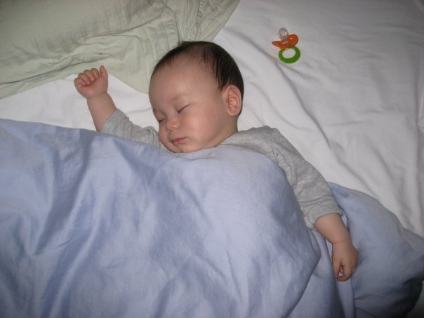
BE AWARE OF UNCONSCIOUS BIAS
Notes:
Google HR is devoted to using analytical and data driven approaches to people issues and they published a fantastic video about unconscious bias. I highly recommend you watch it.It's very important to draw a distinction between having bias and being racist and sexist.Let's start with a simple example.

Slide 28
“
IN THE U.S. POPULATION, ABOUT 14.5 PERCENT OF ALL MEN ARE SIX FEET OR OVER. AMONG CEOS OF FORTUNE 500 COMPANIES, THAT NUMBER IS 58 PERCENT
“
- MALCOM GLADWELL
Notes:
Clearly height is an indicator of being a good CEO then, right?

Slide 29
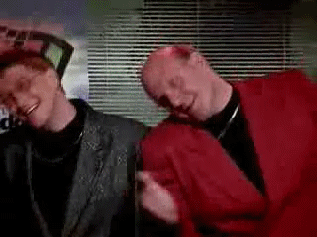
Bill Gates – 5’ 9”
Steve Ballmer – 6’ 5”
Notes:
Or have our biases associated certain qualities with taller people? In fact, many studies show that the quality and track records of CEOs is abysmal and that the qualities we tend to look for in CEOs are antithetical to their success. We promote sociopaths. These traits are not correlated with success like the ones that Kathleen Dollard’s touched upon in her talk Sunday night.
As you can see, biases apply to all sorts of traits. It's not just about race or gender.Let's look at another study.

Slide 30
In a randomized double-blind study, science faculty from research-intensive universities rated the application materials of a student—who was randomly assigned either a male or female name—for a laboratory manager position. Faculty participants rated the male applicant as significantly more competent and hireable than the (identical) female applicant. These participants also selected a higher starting salary and offered more career mentoring to the male applicant.
Notes:
Ok, there’s a lot of words here, but I’ll summarize. Kathleen mentioned this study. A double blind study showed that faculty of research intensive universities rated male applications as more competent, and hireable. They offered more mentoring to the male applicants. But the applications were exactly the same. The only difference is they were randomly assigned a stereotypically male or female name. That was the only difference. Now here's the kicker.

Slide 31
The gender of the faculty participants did not affect responses, such that female and male faculty were equally likely to exhibit bias against the female student.
Notes:
See! Us men don't have a monopoly on being assholes! Let this sink in. Kathleen told a great story about how she misjudged a woman attending her talk and assumed she was not technical. It’s because these biases are socialized into us from a very young age. It’s the messages we receive from the media (like the Silicon Valley show), from people around us, etc. Kathleen is biased. You are biased. Don't worry, so am I.

Slide 32
Don’t feel blamed, be conscious of it
https://implicit.harvard.edu/implicit/
Notes:
This is why I’m not up here to blame or shame you. That’s not my style. I prefer to identify the problem and work towards a solution. We all carry unconscious bias. We can't assume just because _we_ never "witnessed it" it doesn't exist. And if you don't believe it, try taking some of the implicit bias tests. As project maintainers, we can consider the unconscious biases we have and try and make them conscious. Don’t give into your first impulse but ask yourself, Am I scrutinizing and nitpicking this PR because I do that with every one or is it because the contributor is a woman? Am I being patronizing? Am I giving preference to the MS employee in this debate? Or as it might happen among this audience, holding it against them?

Slide 33
Hold each other accountable
Notes:
When men learn about this, the natural tendency is to go to women and put it on them to make sure to call out this behavior when they see it. "Hey, if you ever see me engaging in microaggressions, call me out."In doing so, we put the responsibility on those who we're aggressing. We need to hold each other accountable. We need to hold ourselves accountable. We can put systems in place that help with this. For example, clear policies around contributions, giving commit access, etc..

Slide 34
Promote Work Time OSS Contribution
Notes:
We often hear that GitHub is your resume. On one hand, that's great. Being able to see someone's work is a great input into a hiring decision. On the other hand, if participation in OSS is skewed so heavily against marginalized people, then using it as a recruiting and hiring tool only makes the overall tech audience even more homogenized. Encourage the companies where you work to allow employees to use work time to contribute back to OSS. If you're a manager, give your people time to contribute back. It's not only good for the benefit of these projects, This helps everybody build up an OSS resume and helps make contributing accessible to a wider swatch of people.

Slide 35
OSS Contribution Benefits
Notes:
For the business, this produces amazing benefits. The businesses are already leveraging OSS code more and more. Having contributors on staff provides more influence in the direction of key OSS software. A bug or design decision affects you negatively? Well good thing you have respected contributors on staff to make your case or to fix the bug.Also, contributing back gives your people the chance to stretch their skill sets. Work on technology they wouldn't otherwise get a chance to. If you send them to training, you pay twice, the opportunity cost for their time off, and the cost of the travel + training. Giving them time for OSS only costs the time off. And that cost is paid back immensely.

Slide 36
Support Programs That Help
Google Summer of Code
Black Girls Code
Rails Girls Summer of Code
Code 2014
Notes:
Support programs that pay people to work on OSS

Slide 37
Be Better Maintainers
Notes:
As maintainers, we have to remember to be nice and welcoming.

Slide 38

THANK YOU FOR THE PULL REQUEST!
People new to open source find it intimidating
Untitled by New Zealand Defense Force License: CC BY 2.0

Slide 39
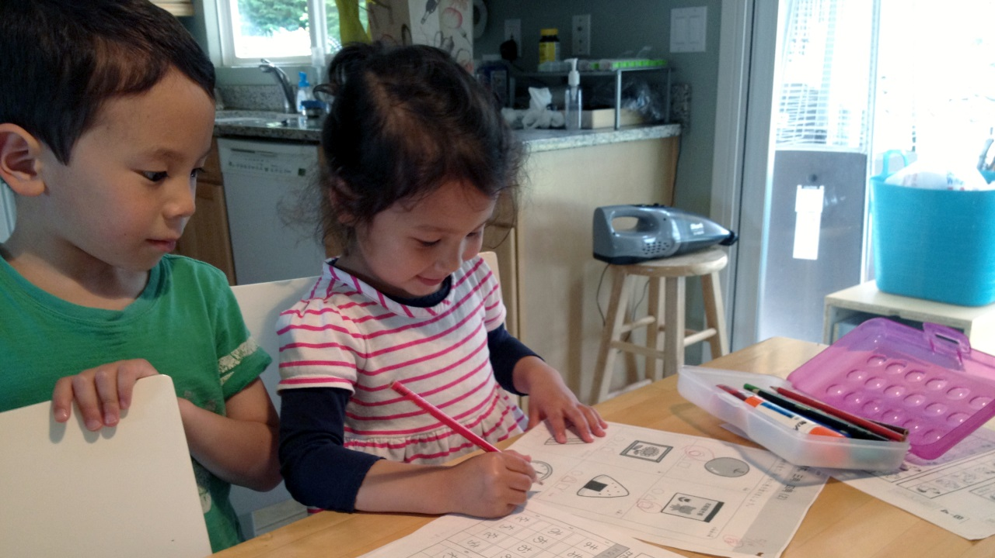
Review new contributions like a child’s drawing
Notes:
An analogy that Michael Meeks came up with in his presentation “Interacting with new developers” is to…

Slide 40
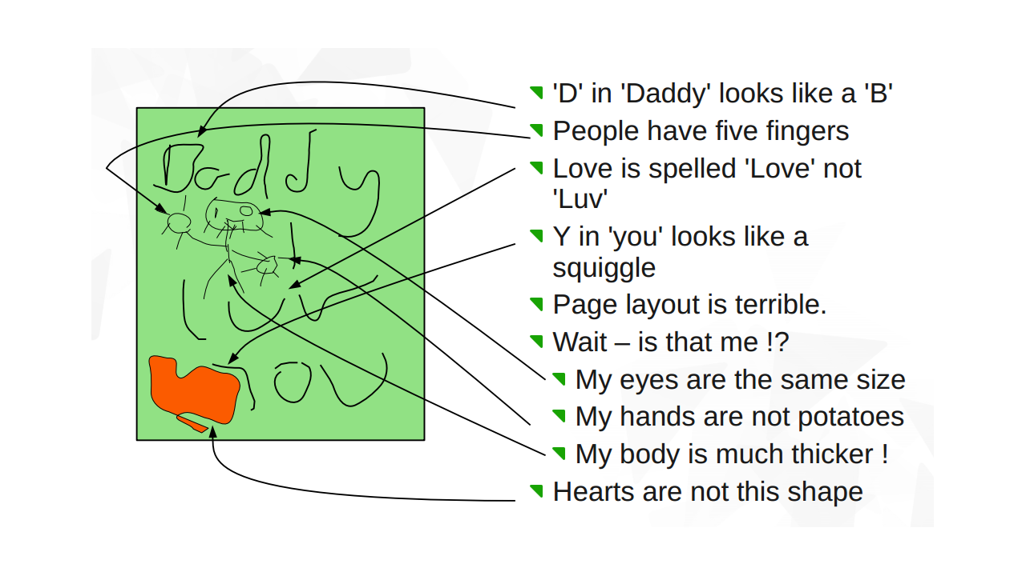
Notes:
review new contributions like a child's drawing. Your kid comes to you with a drawing, you wouldn't do this:

Slide 41
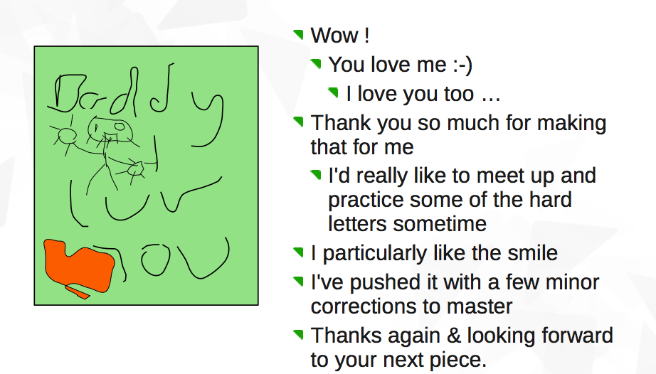

Slide 42
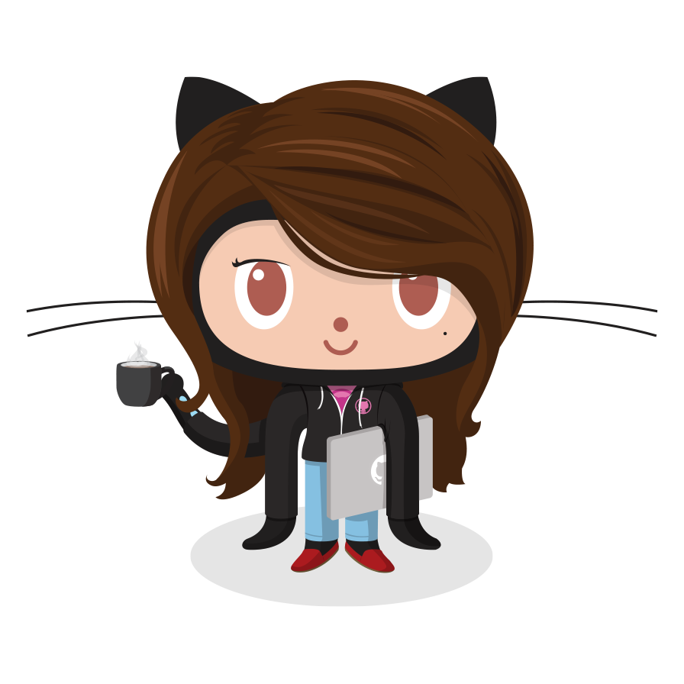
Notes:
So as you leave this talk and this conference, I hope you take away a few things.
1. The Open Source community is inspirational, but could be an even more positive force for change.
2. You, me, everybody. We are part of the problem. In a way, it's not our fault. It's unconscious and implicit.
3. We, as in me and you in this room, don't have to accept the status quo. We have the power and ability to make it better. We can start with the small corner of the OSS community we call ours and make it better. Go forth and be awesome. Thank you.
BTW, I have a women coder octocat stickers for anyone who wants them. The interesting thing here is that the Octocat’s official name is Ms. Mona Lisa Octocat so technically all Octocat stickers are women. ☺

Slide 43
https://www.gv.com/lib/unconscious-bias-at-work
https://implicit.harvard.edu/implicit/takeatest.html
https://devmynd.com/blog/2015-2-mind-the-gap
https://twitter.com/freebsdgirl/status/571350489649950720
http://www.businessinsider.com/google-course-on-unconscious-bias-2014-9#ixzz3X35iqeGy
http://geekfeminism.wikia.com/wiki/Geek_Feminism_Wiki
https://twitter.com/nrrrdcore/status/575569430538776578
http://www.catalyst.org/media/companies-more-women-board-directors-experience-higher-financial-performance-according-latest

